Slide 1
SOC Analyst’s Arsenal
Essential Tools, Tips and Tricks for Effective Investigations
Notes:
Welcome everyone, today I will be talking about SOC things, specifically tools used by analysts in a SOC.
Goal of this talk is to give you atleast one idea on how to make your investigations more efficient or faster. Lets begin

Slide 2
Whoami
Samuel Kavaler
SOC Team Manager @ Ontinue
6 years of experience in Cyber Security
primary focus on SOC processes and people

Slide 3
Agenda
OPSEC
REPUTATION ENGINES
TOOLS
AUTOMATION
OSINT
LOG TRANSFORMATION
EDUCATION

Slide 4
Opsec
Analysts need to be trained on OPSEC
Uploading files into public engines – a big no-no
Make sure links don’t contain user emails (base64)
Provide guidance to your your Service Desk
MSSP - clean templates, note taking
Consider separate unfiltered / anonymous internet access
Notes:
Analysts needs to be trained on OPSEC
If you are uploading suspicious links to VT - make sure these does not contain users email addresses as attackers sometime prefill the user field (can be in encoded in base64)
Uploading files into public engines is a big no-no – you don’t want to tip off the threat actors by uploading their new malware to VT, because if you are targeted, they will be watching
Next, I would recommend chatting with your Service Desk Management and ask if your users send them suspicious files, if that is the case provide guidance to your SD on the process
If you are MSSP and serve multiple customers – create training for your new joiners on how to use clean templates for customer communication, note taking, not everyone is well organized and you want to make sure there is no cross customer information sharing
Last point, consider dedicated external internet connection that doesn’t have an IP associated with your organization. This can be useful for sensitive investigations or when analysts want to download exploit files for analysis and testing.

Slide 5
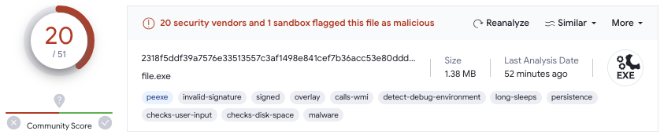
virustotal
Notes:
Everyone knows VirusTotal, but in my experience not everyone is aware about some features so let me highlight some of the functionalities starting with file hash lookups
Not just score, file size can sometimes tell you more and more important always check Last Analysis date, Reanalyse

Slide 6
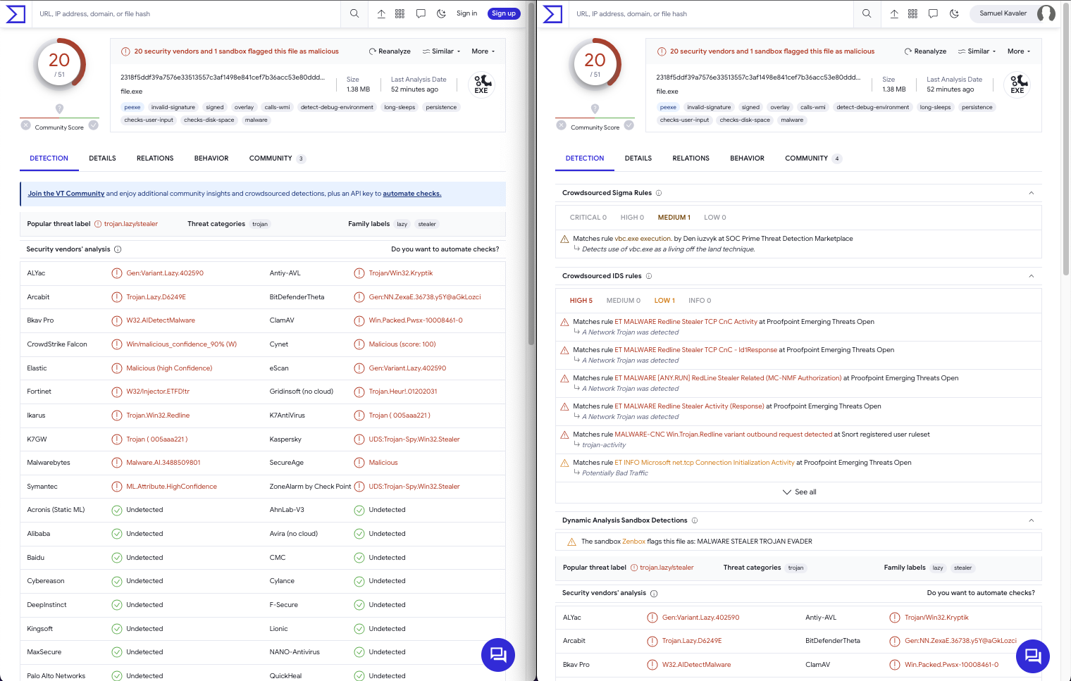
Notes:
Starting with the main view, the Detection tab
This is the same file open in two tabs, but on the right side I am signed in with a free account.
If you sign in, you get all the extra detection information like Sigma rules, IDS rules and Sandbox results details

Slide 7
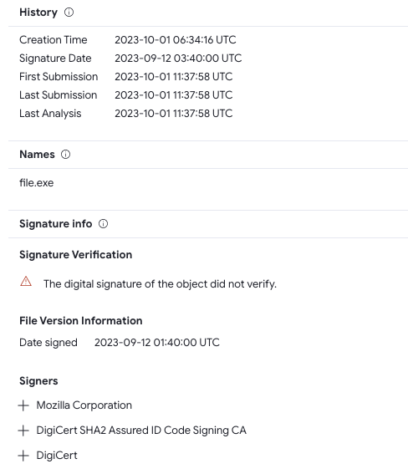
Details tab
History (dates)
Names
Signature info
Notes:
History – one of the most important information is First submission which tells us what is the minimal age of the file, this can sometimes give great context to your investigation. Don’t rely on Creation Time can be spoofed.
Threat actors like to rename tools and the Names section can provide useful information if the file you are interested in was renamed.
Is the file signed and who are the Signers

Slide 8
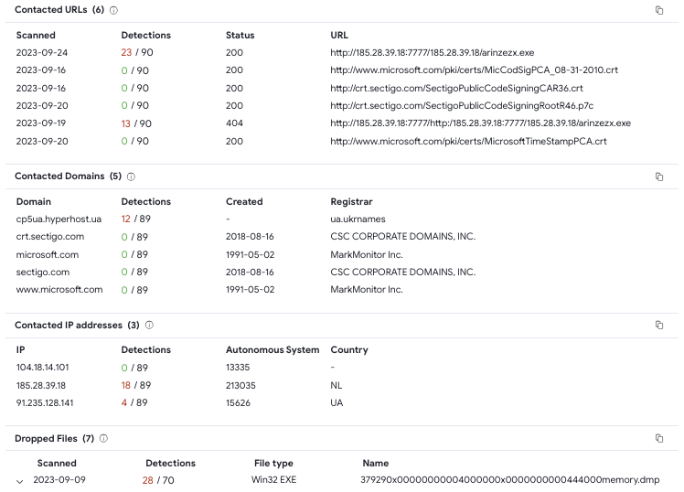
Relations tab
Contacted URLs
Contacted Domains
Contacted IP addresses
Dropped Files
Notes:
Relation tab provides access to potential IOCs - Contacted URLs, Domains and IP addresses

Slide 9
Notes:
Also dropped files can provide information, for example ransomware notes
Please note the Copy icons on the right side of the screenshots

Slide 10
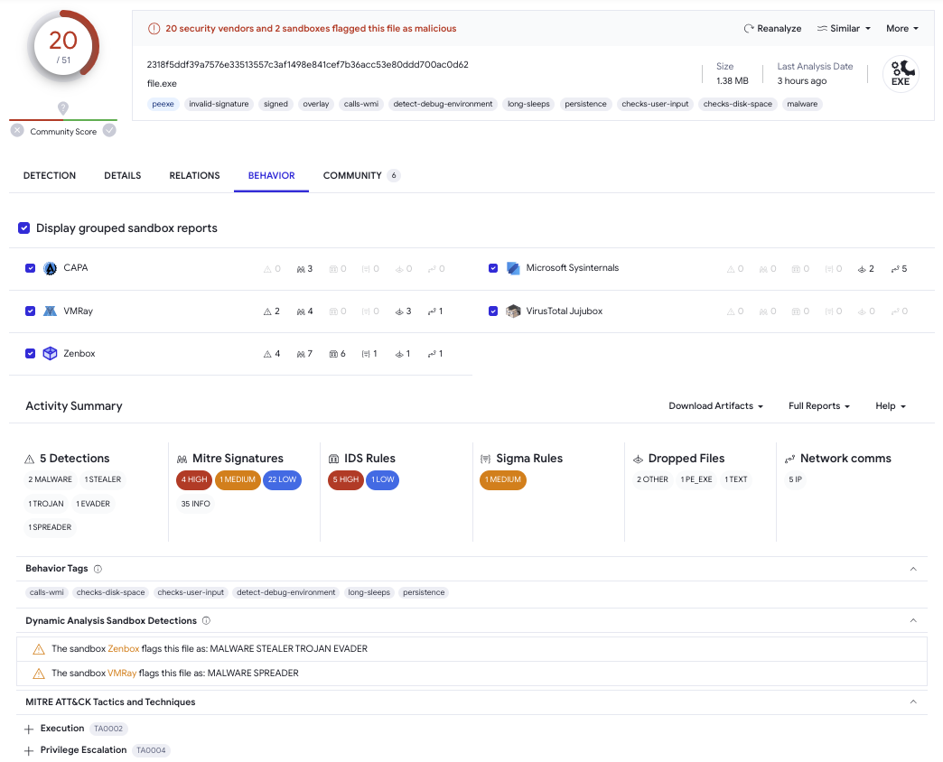
Notes:
Behavior tab with the sandbox reports if you want to dig deeper, sometimes the reports contain screenshots

Slide 11
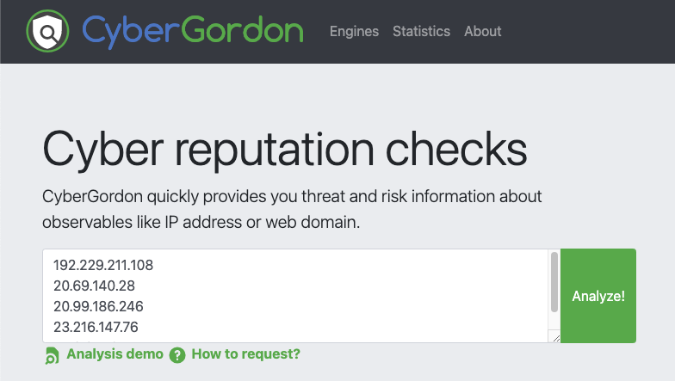
CYBERGORDON
Observables
IP
FQDN
URL
Hashes
Email
Notes:
Cybergordon is personal project by Marc-Henry Geay, where you upload up to 10 observables at once and it will check if there are any existing records

Slide 12
IP LOOKUPS
AbuseIPDB
Shodan
GreyNoise
Notes:
Besides Virustotal, Shodan for open ports / services

Slide 13
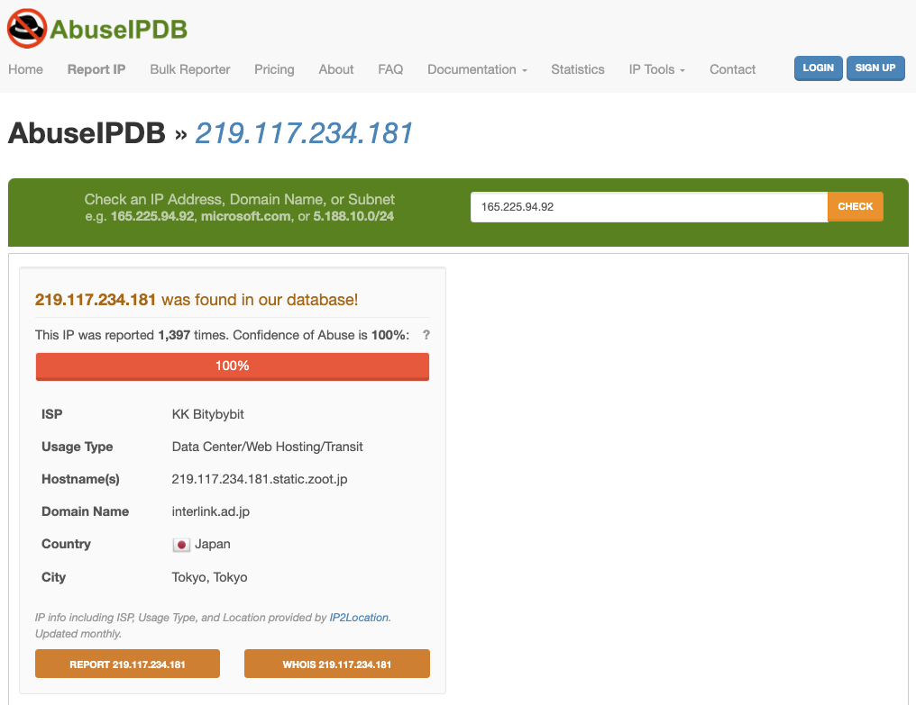
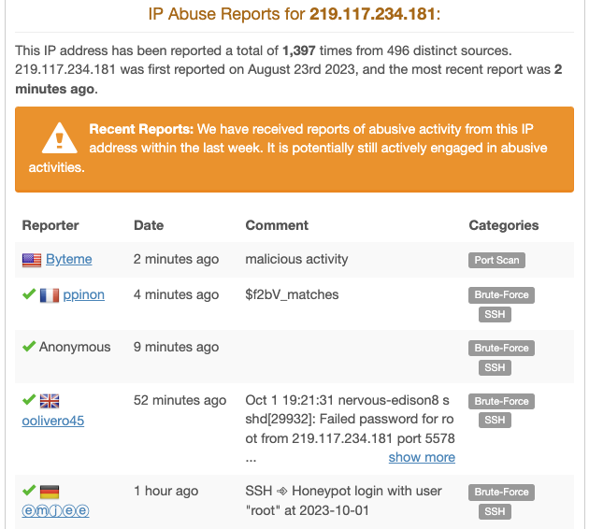

Slide 14
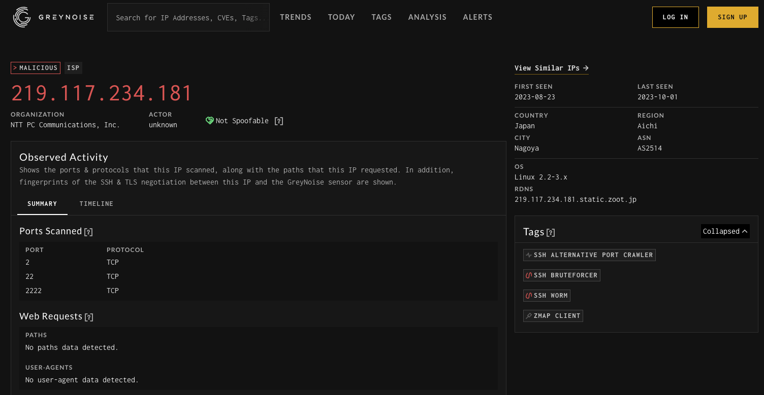
Notes:
Greynoise will give you warnings like this IP is opportunistically scanning for XYZ vulnerability

Slide 15
URL LOOKUPS
urlscan.io
browserling.com
app.any.run

Slide 16
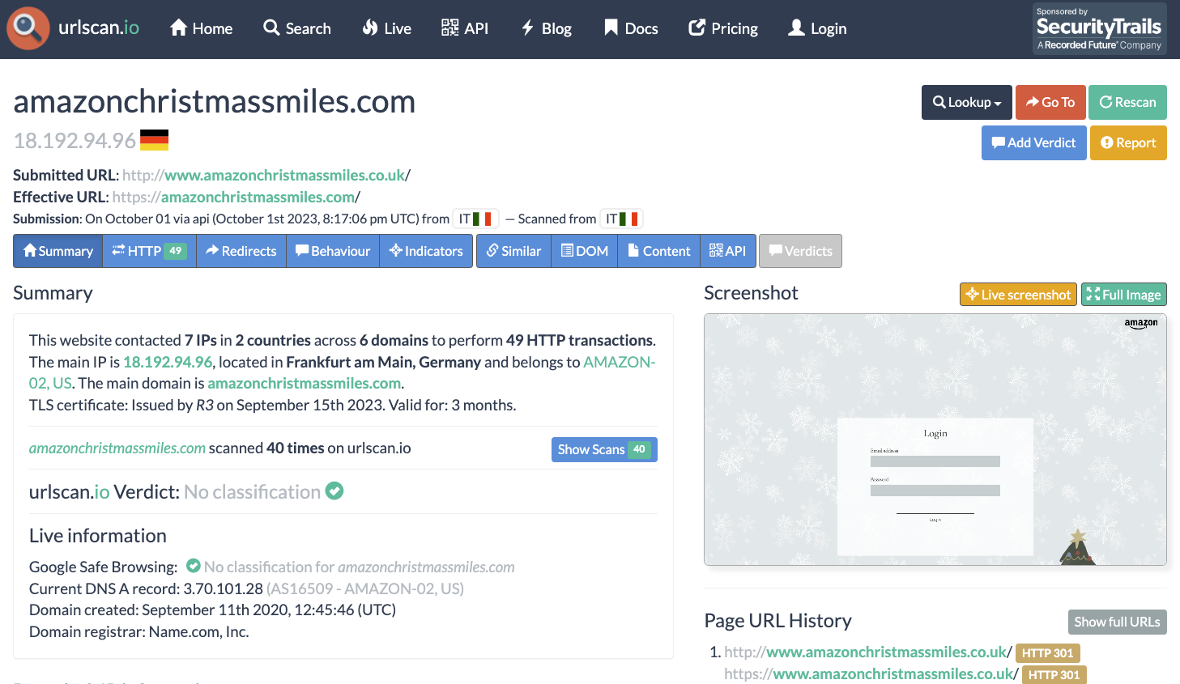

Slide 17
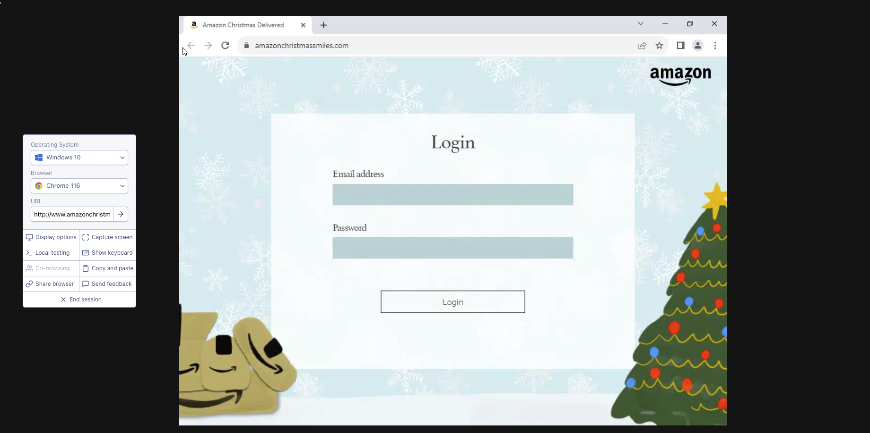

Slide 18
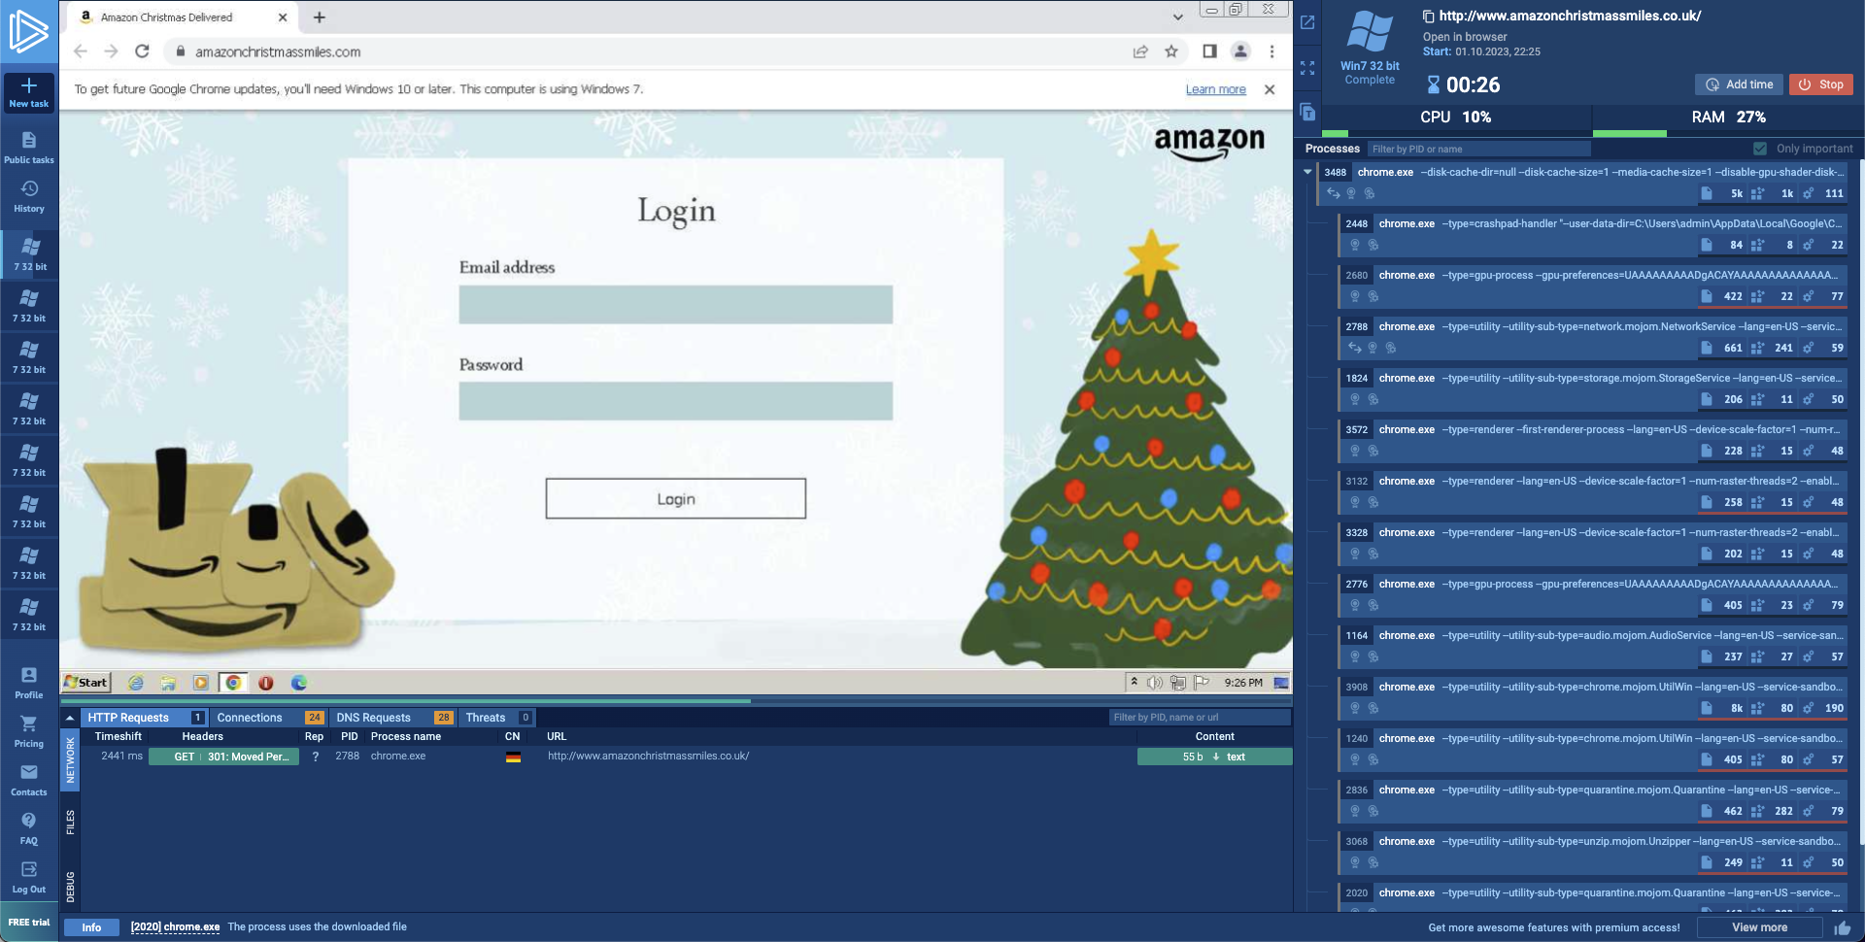

Slide 19
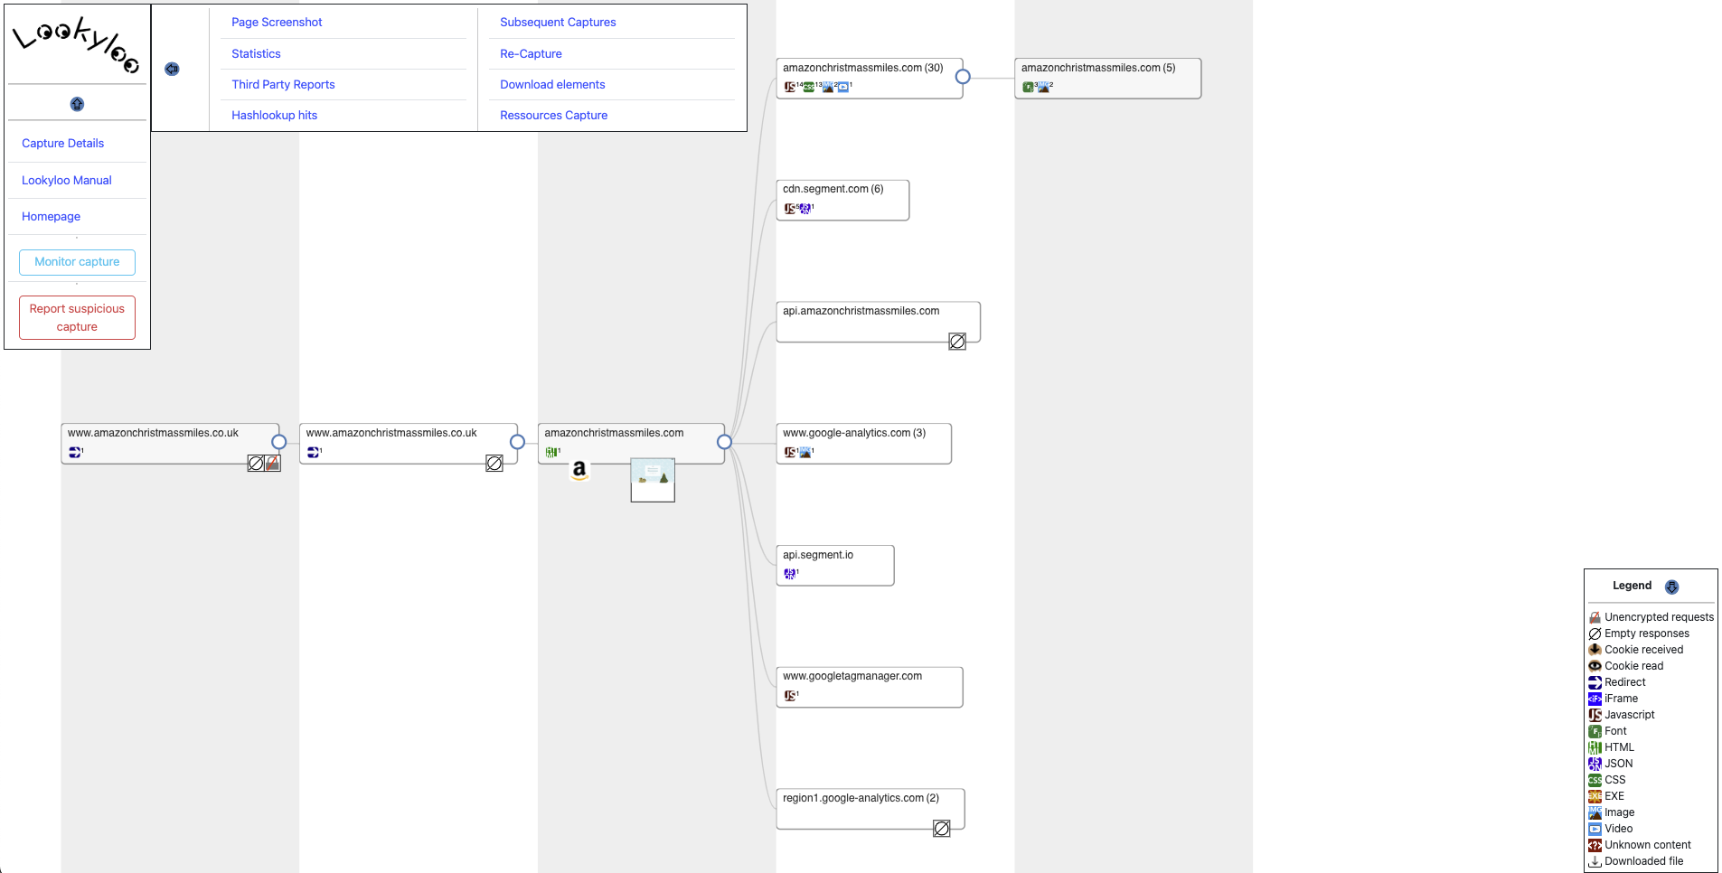
lookyloo.circl.lu
Notes:
Lookyloo is a web interface that captures a webpage and then displays a tree of the domains, that call each other.
lookyloo.circl.lu

Slide 20
EMAIL HEADER ANALYSIS
mxtoolbox.com
mha.azurewebsites.net

Slide 21
PCAP Analysis
Wireshark
Customize your profile and Columns
Brad Duncan
https://www.malware-traffic-analysis.net/tutorials/index.html
Chris Greer
https://www.youtube.com/@ChrisGreer

Slide 22

EVTX Analysis
Chainsaw
Search through event logs using string matching and regex patterns
Hunt for threats using Sigma detection rules
Shimcache analysis
Notes:
Windows event logs
Also Shimca

Slide 23
Automation?
How to be more efficient and make your life easier?

Slide 24

Autohotkey
Open source scripting language for Windows that can save your time, keystrokes and mouseclicks by making customized shortcuts and scripts.
Hotstrings
Hotkeys
Notes:
Open source scripting language for Windows that can save your time, keystrokes and mouseclicks by making customized shortcuts and scripts.

Slide 25
Hotstrings
Used to expand abbreviations as you type them (auto-replace)
::btw::by the way
::#@::mylongemail@protonmail.com
::#ho::Hornických učňů 123
::#fpu::False Positive - confirmed with the user
Notes:
Hotstrings are used to expand abbreviations as you type them (auto-replace)
Great if you need to use some kind of template, don’t need to copy paste every time

Slide 26
Hotstrings
::#tt::
(
Description
Entities
Analysis
Verdict
)

Slide 27
Hotstrings

Slide 28
Hotkeys
Can trigger action such as launching a program or keyboard macro
+n::Run, mynotes.txt
^h:: { Send, ^c Sleep 10 Run, https://www.virustotal.com/gui/file/%clipboard% Return }
^ == Ctrl + == Shift ! == Alt
Notes:
Hotkeys can trigger action such as running a program, opening a file or keyboard macro
Open notes, open hash in Virustotal

Slide 29
Hotkeys
Notes:
IP address search

Slide 30
Hotkeys (ahk v1)
^g::
{
Send, ^c
Sleep 10
Run, https://www.virustotal.com/gui/ip-address/%clipboard%
Run, https://www.abuseipdb.com/check/%clipboard%
Run, https://otx.alienvault.com/indicator/ip/%clipboard%
Run, https://viz.greynoise.io/query/?gnql=%clipboard%
Run, https://talosintelligence.com/reputation_center/lookup?search=%clipboard%
Return
}
^ == Ctrl + == Shift ! == Alt
Notes:
IP address search

Slide 31
Hotkeys (ahk v2)
^g::
{
A_Clipboard := ""
Send "^c"
ClipWait
Run "https://www.virustotal.com/gui/ip-address/" A_Clipboard
Run "https://abuseipdb.com/check/" A_Clipboard
Run "https://otx.alienvault.com/indicator/ip/" A_Clipboard
Run "https://viz.greynoise.io/query/?gnql=" A_Clipboard
Run "https://talosintelligence.com/reputation_center/lookup?search=" A_Clipboard
}
^ == Ctrl + == Shift ! == Alt
Notes:
IP address search

Slide 32
Powertoys run
Quick launcher for Windows power users
https://learn.microsoft.com/en-us/windows/powertoys/run
Quick Lookup Plugin by Mitchell Smith
https://github.com/GTGalaxi/quick-lookup-ptrun
Notes:
PowerToys Run is a quick launcher for windows power users. Main fuctionalities are searching, command execution, and lot more. It also supports custom pluggins and there is one from Mitchel Smith that does similar thing to what I showed with Autohotkey. You can also make something similar easily with Python,

Slide 33
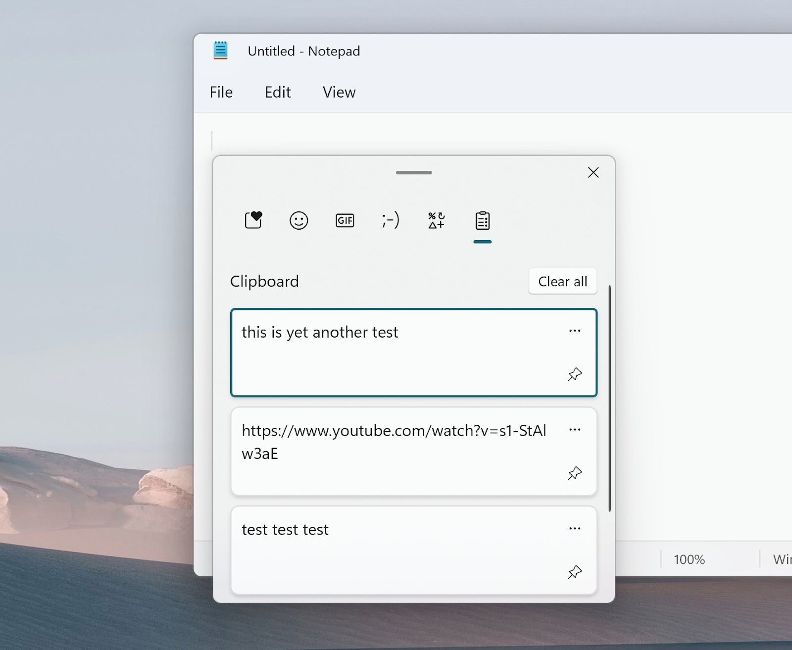
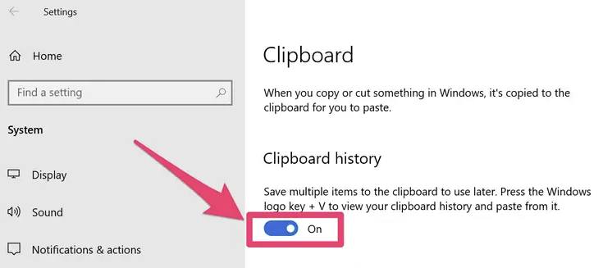
Clipboard history
Mac - CopyLess 2
Notes:
Clipboard history
CopyLess 2 – clipboard manager for Mac

Slide 34
osint
Google dorks
“Zusy” AND “IOCs”
"xcopy" AND (site:attack.mitre.org OR site:thedfirreport.com)

Slide 35
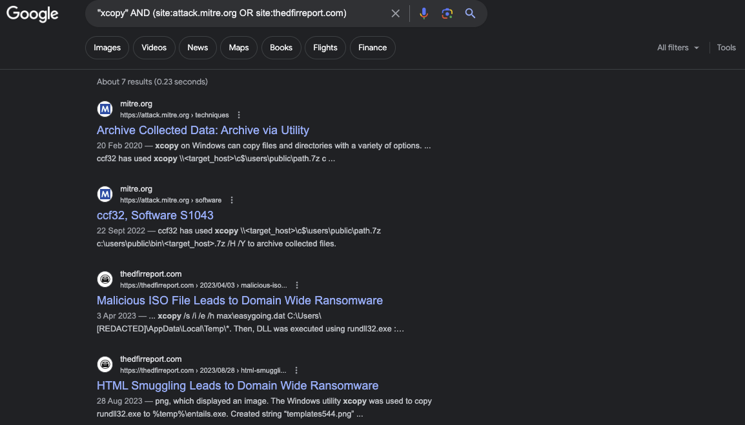

Slide 36
osint
haveibeenpwned.com
chat.openai.com

Slide 37
Log Transformation
regex
grep | sort | uniq > output
Notes:
awk, sed

Slide 38

Cyberchef
github.com/mattnotmax/cyberchef-recipes
huntress.com/blog/advanced-cyberchef-tips-asyncrat-loader
Decode base64
Defang IP / URL
Diff
Reverse
Sort
Unique
Regex
Find / Replace
Remove whitespace / null bytes
Extract IPs/emails/URLs/domains
Syntax highlighter
Code beautify
Notes:
Matthew Brennan – Huntress - malware analysis

Slide 39
Visual Studio CODE
Multi cursor functionality for easy log manipulation
Add Cursors to Line Ends
Select All Occurrences

Slide 42
Education
thedfirreport.com
adsecurity.org/?page_id=4031
Backdoors & Breaches

Slide 43
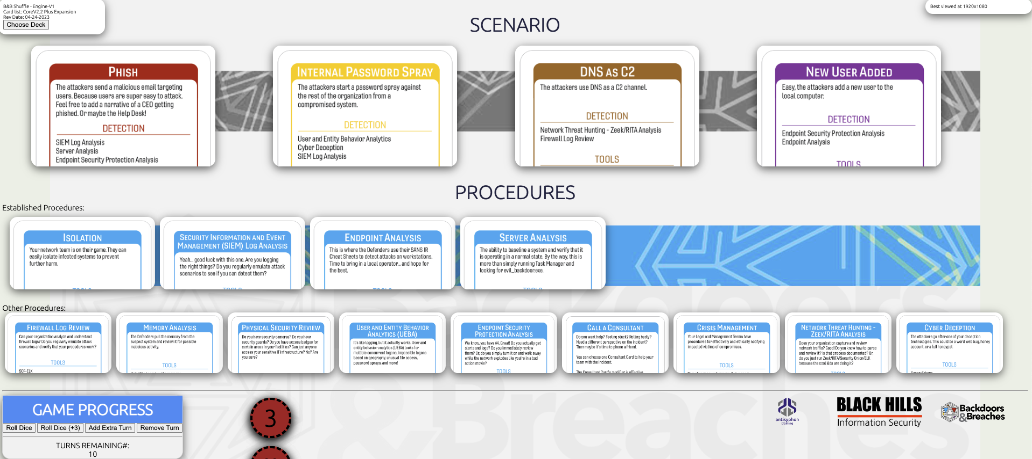
Backdoors & Breaches

Slide 44
Backdoors & Breaches
BHIS | How to Use Backdoors & Breaches to do Tabletop Exercises and Learn Cybersecurity
youtube.com/watch?v=pMY2HXUrKsg

Slide 45
Thank you!
linkedin.com/in/samuel-kavaler

